Slide 1
Segment Pricing
Module 6 · Video 4
Management 405
Prof. Nico Voigtländer · UCLA Anderson

Slide 2
Module 6 · Video 4 · Agenda
Outline of Module 6
1
Simple vs. Complex Pricing
Video 2
2
Direct Price Discrimination
Videos 3+4
2a
Perfect Price Discrimination (First Degree)
Video 3
2b
Segment Pricing (Third Degree)
Different prices for groups with different price sensitivity
Video 4
3
Indirect Price Discrimination (Second Degree)
Video 5
4
Advanced Pricing Strategies
Videos 6–8
4a
Flat Fee Pricing
Video 6
4b
Two-Part Tariff
Video 7
4c
Block Pricing
Video 8
5
Summary of Pricing Strategies
Video 9
Management 405 · Module 6 · Complex Pricing and Advanced Pricing Strategies
2
Notes:
Now the case firms actually use: sorting customers into groups.

Slide 3

Module 6 · Video 4 · Segment Pricing (Third Degree)
Third Degree Price Discrimination: Segment Pricing (Group Pricing)
Divide customers into different groups with different price sensitivities, and charge each group different prices
Conditions:
  Consumer groups with (on average) different MPV
  Firm can identify these groups
  Firm has market power and can prevent resale
Management 405 · Module 6 · Complex Pricing and Advanced Pricing Strategies
3
Notes:
Third-degree pricing splits customers into groups with different price sensitivities and charges each group its own price. Seniors at the cinema are the everyday example. It needs three things: groups that really do differ on average, a firm that can identify them, and no resale between them.

Slide 4

Module 6 · Video 4 · Segment Pricing (Third Degree)
Segment Pricing
Price
Divide customers into different groups with different price sensitivities
Charge each group different prices (lower prices to more elastic groups)
P₁
P₂
Regular
movie-goers
Seniors
D
Q
Management 405 · Module 6 · Complex Pricing and Advanced Pricing Strategies
4
Notes:
We reintroduce segment pricing, a concept already introduced in week 2 when we discussed Mercedes's optimal pricing in the US and Germany, based on different elasticities. On this slide it is the cinema: seniors pay less than regular movie-goers, which is price discrimination by age. Why set different prices for different segments? Because the segments have different demand elasticities, and with marginal cost the same in both you want marginal revenue equal across them, which means the lower price goes to the more elastic segment. So why are seniors more price sensitive? Lower income, and a much lower opportunity cost of time. A retired person can take the cheap Tuesday matinee, or drive around for a better deal at the car wash, in a way a working professional cannot. The professional is buying the convenient showing rather than the cheapest one.

Slide 5

Module 6 · Video 4 · Segment Pricing (Third Degree)
Segment Pricing: Student Discounts
Management 405 · Module 6 · Complex Pricing and Advanced Pricing Strategies
5
Notes:
Why would you charge lower price to students? lower incomes and more free time. As a result, they are more price-elastic and it is optimal to offer them discounts.
Important: you need to “verify” that they are indeed students.

Slide 6

Module 6 · Video 4 · Segment Pricing (Third Degree)
Segment Pricing: Ways to Segment Consumers
By customer characteristics
  Age, gender, …
  But even by ‘customer’ species: doctors and veterinarians sometimes use the same medicines
  Discounts for new customers (gym memberships)
By location
  Pharmaceuticals in the US vs. emerging economies
Intertemporal
  Electronic gadgets: early adopters vs. mass market
  Black Friday
Management 405 · Module 6 · Complex Pricing and Advanced Pricing Strategies
6
Notes:
For next slide: the price of Lodine for humans is three times the price for animals

Slide 7
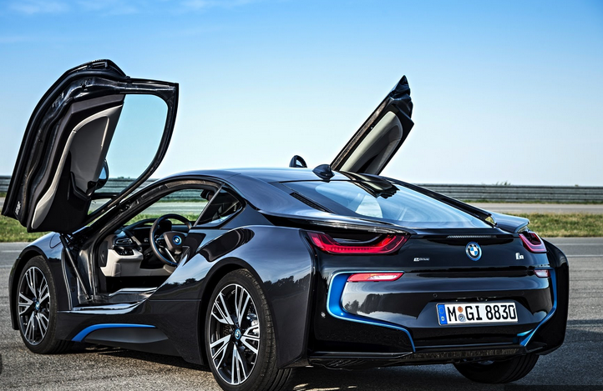

Module 6 · Video 4 · Segment Pricing (Third Degree)
Segment Pricing: Analysis for Two Markets
A firm produces the same product for two markets
  E.g. cars
Should the price be the same in both markets?
  Not necessarily!
$${MR}_{i} = {MC}_{i} in each market i$$
Rule: prices differ if demand (MR) and/or costs (MC) differ
Charge the lower price in the more elastic market
Practice Video: Optimal Pricing in Two Markets
Management 405 · Module 6 · Complex Pricing and Advanced Pricing Strategies
7
Notes:
The mechanics are the same rule you already know, applied twice. Set marginal revenue equal to marginal cost in each market separately. Prices come out different whenever demand or cost differs, and the direction is always the same: the lower price goes to the more price-sensitive market. The practice video works this through with BMW's US and German prices.

Slide 8
Module 6 · Video 4 · Segment Pricing (Third Degree)
Segment vs. Uniform Pricing: The Graphical Answer
US market (B)
German market (C)
Joint market (US + Germany) (A)
P
P
P
Kink results from demand aggregation (beyond the scope of this class)
MC
MC
MC
D
MR
D
MR
D
MR
Q
Q
Q
Profit = $450 m
Profit = $1,250 m
Profit = $1,600 m
Segment pricing: $1,700 m > uniform pricing: $1,600 m
Practice Video: Optimal Pricing in Two Markets
Management 405 · Module 6 · Complex Pricing and Advanced Pricing Strategies
8
Notes:
Here is why splitting the market pays. On the left the firm treats the US and Germany as two markets and sets marginal revenue equal to marginal cost in each one, so it sells 30 thousand cars at $60 thousand in the US and 50 thousand at $70 thousand in Germany. The two profit rectangles are B and C. On the right it charges one price to both countries together; the best it can do is $65 thousand on 80 thousand cars, which is rectangle A. B plus C comes to $1.70 billion, A comes to $1.60 billion. The gap is about 6 percent, and it is always in the same direction: charging one price to two different demand curves can never beat charging each of them its own price.

Slide 9
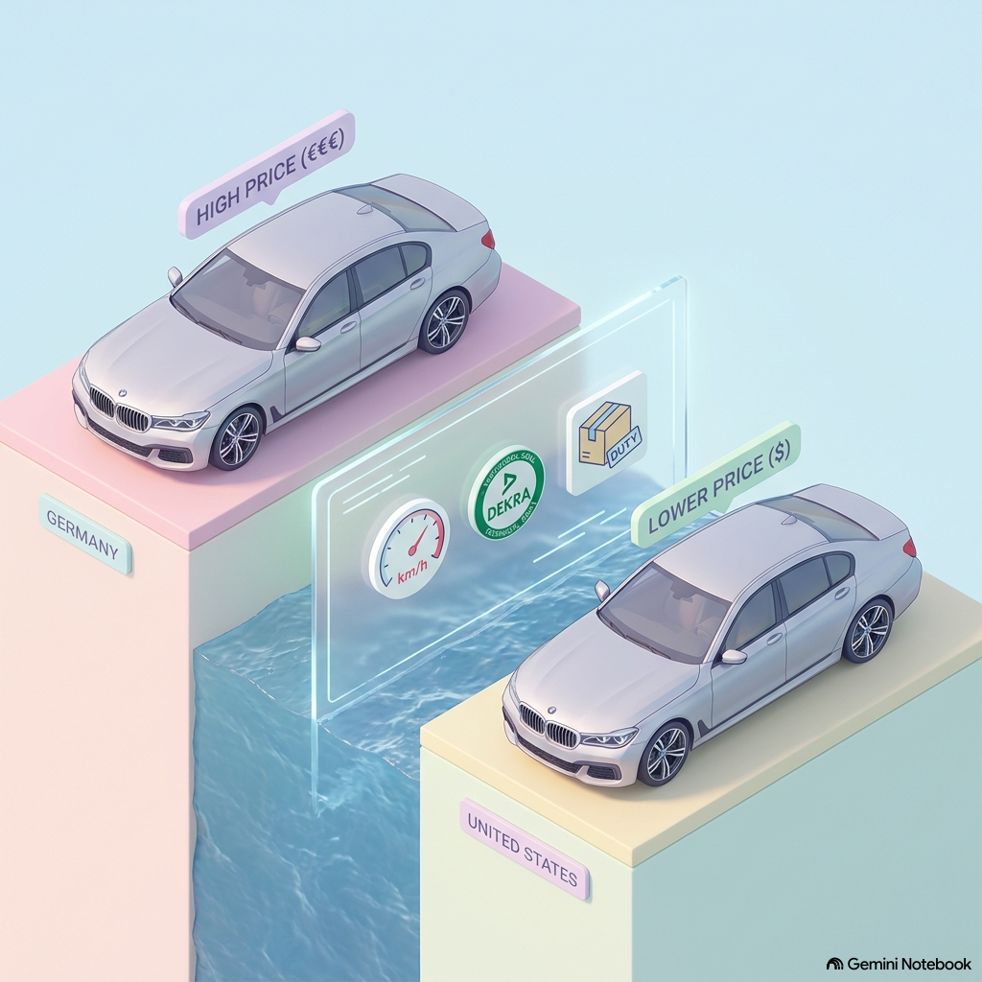
Module 6 · Video 4 · Segment Pricing (Third Degree)
Challenges with Segment Pricing for BMW
Suppose BMW sets very different prices in Germany vs. U.S.
Do you anticipate any problems?
  Arbitrage: re-importation from the cheaper market
    Difficult in this particular case (e.g., miles vs kilometers; taxation)
    However, easier in other cases (e.g., buying textbooks in India and reselling them in the US)
  Consumer backlash
Way around these problems: versioning — second degree price discrimination
Management 405 · Module 6 · Complex Pricing and Advanced Pricing Strategies
9
Notes:
Segment pricing only survives if the segments stay apart. Between Germany and the US that is easier than it sounds for cars, because of instrumentation and taxes, but textbooks bought in India and resold in the States show how quickly arbitrage can close the gap. Add consumer anger and the Robinson-Patman Act, and you can see why firms often prefer the indirect route, which is where we go next.

